Slide 1

SMART INDIA HACKATHON 2026
CHAKRA
VYUH
TITLE PAGE
Problem Statement ID – SIH26056
Problem Statement Title – Development of a Real-time Airfare Price Index for India through Automated Web Scraping of Airline and Online Travel Aggregator Portals for Augmentation of CPI.
Theme – Travel & Tourism
PS Category – Software
Team ID – [Portal Team ID]
Team Name – CHAKRAVYUH

Slide 2
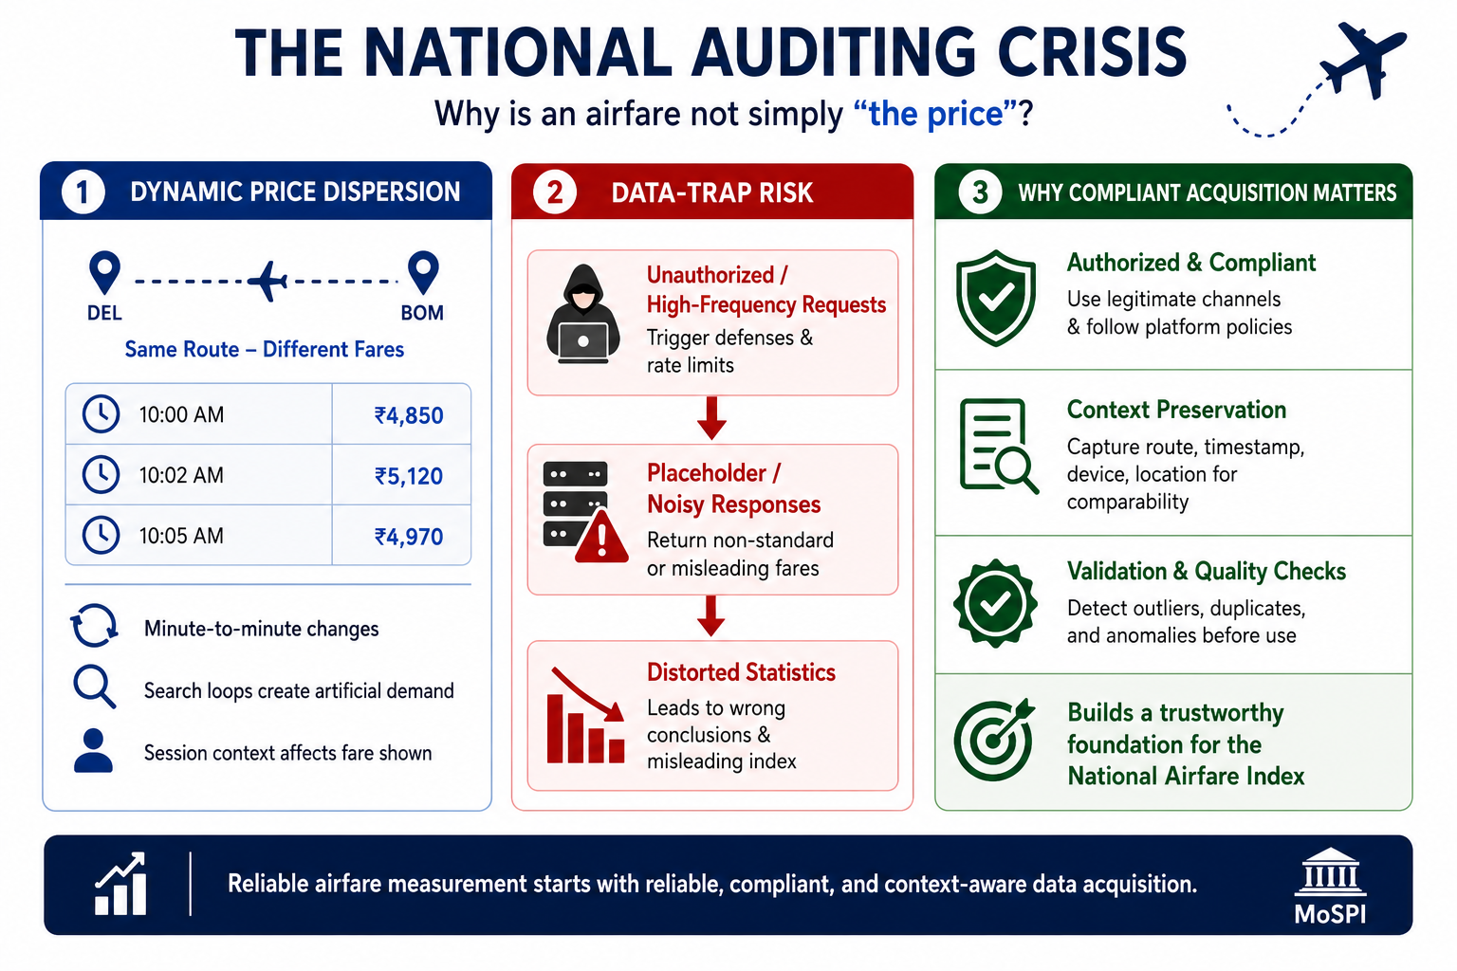
VAYU-SUCHAK
CHAKRA
VYUH
WHAT MoSPI IS ASKING FOR
Turn India's volatile online airfare collection into
A high-frequency, CPI-ready price signal.
Automate collection → clean & normalize quotes → detect anomalies → apply economically meaningful weighting → publish a reproducible index.
DYNAMIC
MULTI-SOURCE
HIGH-FREQUENCY
Fares vary by route, lead-time, demand and timing.
Airlines + OTAs are the real online market surface.
Daily / weekly / monthly index views are required.
OUR DIFFERENTIATOR — SMART AUTOMATION
SCRAPE
SCRAPER-PRIMARY ACQUISITION
CTX
CONTEXT-PRESERVING DATA
IQR
DYNAMIC IQR PURIFIER
Live scraping + cached snapshot fallback
Route • timestamp • lead-time • fare context retained
Configurable k-factor; anomalies flagged + auditable
FEST
FESTIVAL-AWARE SIGNAL
Σ
WEIGHTED LASPEYRES
DB
RESILIENT DELIVERY
Separates temporary demand spikes from structural movement
Base-period volume weights → representative national index
PostgreSQL primary + SQLite WAL resilience + API/dashboard output

Slide 3
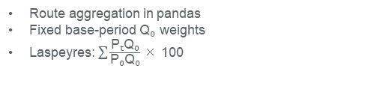
TECHNICAL APPROACH
CHAKRA
VYUH
SOURCE → QUALITY → INDEX
1
SCRAPER
2
NORMALIZE
3
QUALITY GATE
4
WEIGHT
5
INDEX
Live fares
→
Base + tax + total
→
Validation + IQR
→
Q₀ corridor weights
→
Base-100 output
AUTOMATION DECISION
Scraper reachable → ingest via Playwright / XHR interception
Source blocked → cached snapshot fallback | Layout change → vision-LLM self-healing extractor → revalidate
DATA SANITIZATION
INDEX ENGINE
DELIVERY + RESILIENCE
Missing / duplicate / invalid quotes
Base fare, taxes & total fare separated
Festival-season flag retained
Route aggregation in pandas
Fixed base-period Q₀ weights
Laspeyres: $\sum{\frac{\text{PₜQ₀}}{\text{P₀Q₀}}}$ × 100
PostgreSQL authoritative store
SQLite WAL resilience path
Dashboard + API-ready outputs
SMART AUTOMATION PRINCIPLE • ROUTINE WORK IS AUTOMATED; EXCEPTIONS REMAIN TRACEABLE.

Slide 4
FEASIBILITY AND VIABILITY
CHAKRA
VYUH
PROOF OF FEASIBILITY
Example: one anomalous fare enters the pipeline
CHALLENGE → CONTROL
₹4,200 ₹4,300 ₹4,400 ₹4,500 ₹4,600 ₹4,700 ₹25,000
Dynamic / changing fares
→
Timestamp + lead-time context
Q1 = ₹4,350 | Q3 = ₹4,650
₹25,000 > ₹5,100
Noisy / duplicate quotes
→
Validation + IQR gate
IQR = ₹300
Upper Fence = ₹5,100
FLAG → LOG → REVIEW / EXCLUDE
Festival spikes
→
Festival flag; compare with/without
STATISTICAL
Configurable IQR
Weighted Laspeyres
Scrape source blocked
TECHNICAL
OPERATIONAL
→
Cached snapshot fallback
Python + pandas
Scraper ingestion
Provenance + fallback
Audit-ready exceptions
IQR FORMULA
Lower Fence = Q1 – 1.5 × IQR
Upper Fence = Q3 + 1.5 × IQR
KEY PRINCIPLE • FLAGGED ≠ SILENTLY DELETED

Slide 5
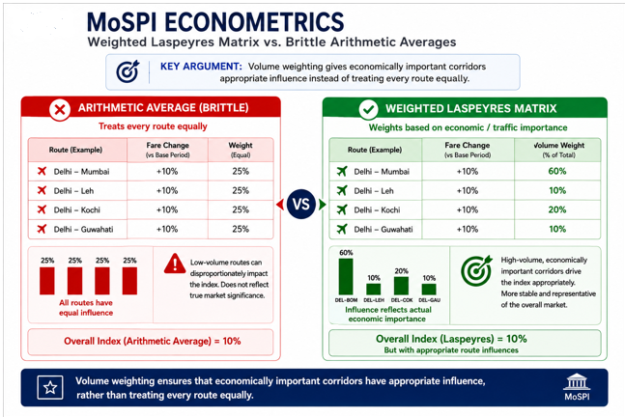
IMPACT AND BENEFITS
CHAKRA
VYUH
WHY THIS CHANGES THE INDEX
ECONOMIC
High-volume corridors get appropriate influence.
STATISTICAL
Less distortion than treating every route equally.
POLICY
Better signal for airfare-driven price movement.
AUDIT
Weights and exclusions remain explainable.
REPRESENTATIVE • REPRODUCIBLE • DEFENSIBLE

Slide 6
RESEARCH AND REFERENCES
CHAKRA
VYUH
RESEARCH → DESIGN DECISION
SIH26056 / MOSPI
Problem asks for automated, scalable airfare collection, cleaning, normalization and real-time index construction.
KEY SOURCES
01 SIH 2026 — SIH26056
DYNAMIC FARE RESEARCH
Minute-to-minute dispersion, search loops and session context make naive collection unreliable.
02 MoSPI — CPI methodology / revised series
Fixed base-period volume weights make the index economically representative.
03 Team research — fare dispersion & integrity
ECONOMETRIC RESEARCH
04 Team research — weighted Laspeyres
VAYU-SUCHAK BLUEPRINT
Scraper-first acquisition, quality gates, festival flagging, IQR purifier and resilient persistence.
05 CHAKRAVYUH — VAYU-SUCHAK blueprint
COLLECT → VALIDATE → SANITIZE → WEIGHT → INDEX → AUDIT

